Slide 1
Family-Owned Business Performance
Group 2

Slide 2




The team
Norman Morris
Yiqing Guo
James Miller
Gavan VanOver
Dev-10 Associate
Dev-10 Associate
Dev-10 Associate
Dev-10 Associate

Slide 3
Introduction

Slide 4
The Data
Data provided by the US Census Bureau
Specifically used the Annual Business Survey (ABS) APIs for 2019
Provided aggregated data on:
Owner Demographics
Firm Sizes
Sales and Revenues
Tech Usage
ETC

Slide 5
Sifting through
The APIs provided a very large amount of data and not all of it was connected.
We decided to specifically focus on the differences between family-owned and non-family-owned businesses in both their demographics and performance.

Slide 6
What we want to know
What are the characteristics of the families that own business?
How do these compare to non-family-owned companies?
What are the typical characteristics of family-owned businesses? (number of employees, amount of revenue, annual payroll, etc.)
How do these compare to non-family-owned companies?

Slide 7
Results

Slide 8
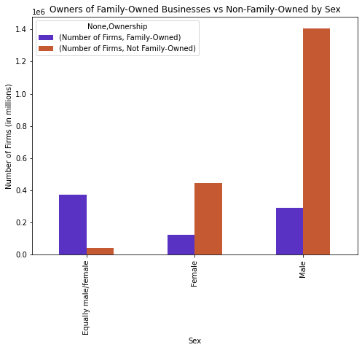
How do the owners of family-owned businesses vs non-family-owned businesses compare by Sex?

Slide 9
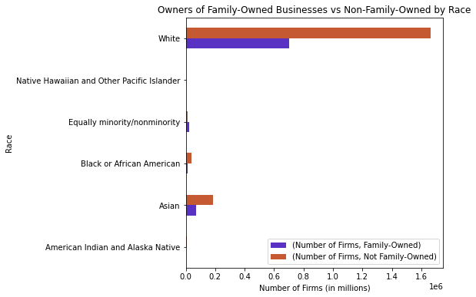
HOW DO THE OWNERS OF FAMILY-OWNED BUSINESSES VS NON-FAMILY-OWNED BUSINESSES COMPARE BY Race?

Slide 10
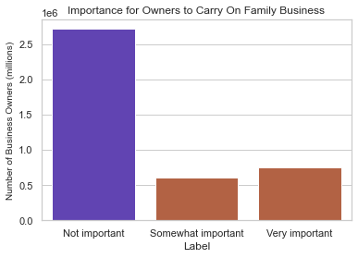
How do all owners rate the Importance of Carrying on the Family Business?

Slide 11
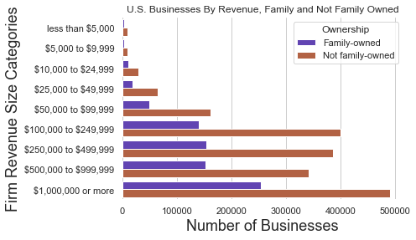
Breakdown of Firm Revenue

Slide 12
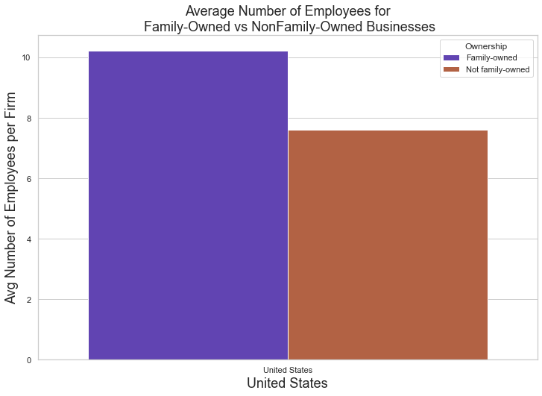
On Average, Do Family-owned businesses have more employees?

Slide 13
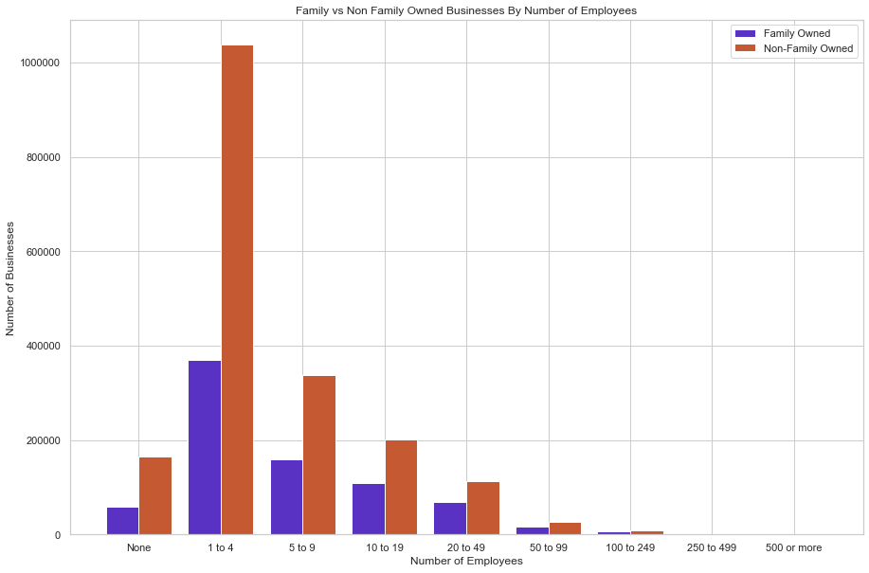
Breakdown of Number of employees

Slide 14
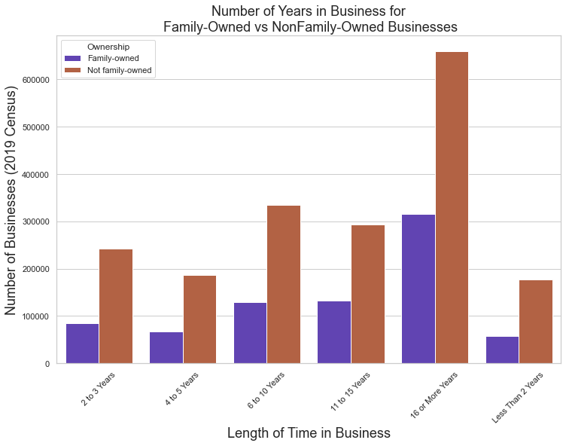
How long have family-owned businesses been operating?

Slide 15
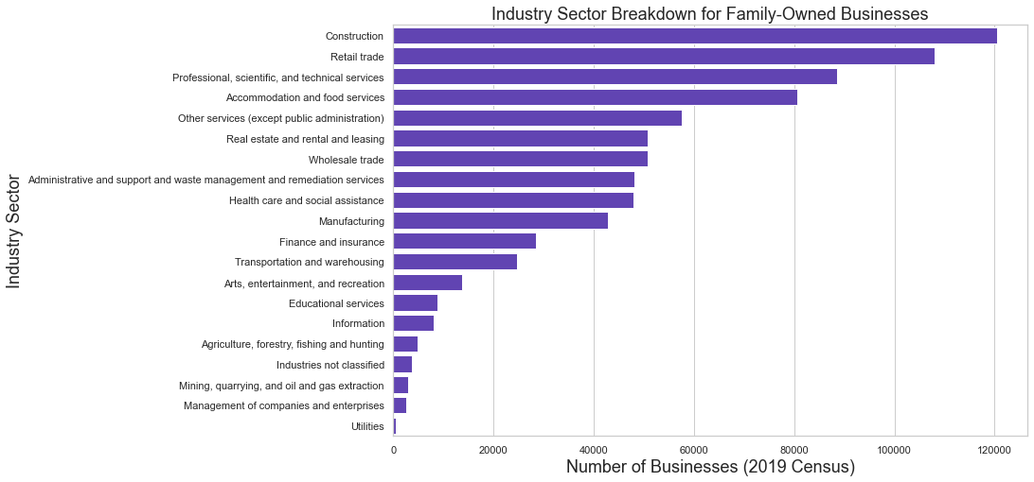
Are family-owned businesses more concentrated in certain industries?

Slide 16
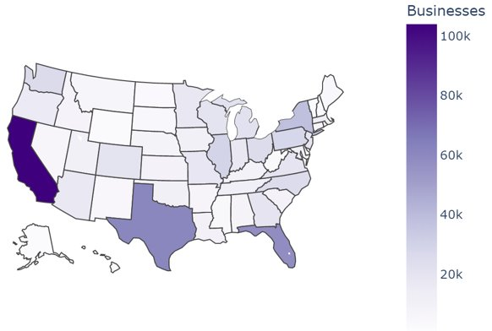

Which states have the most family-owned businesses?
Number of

Slide 17

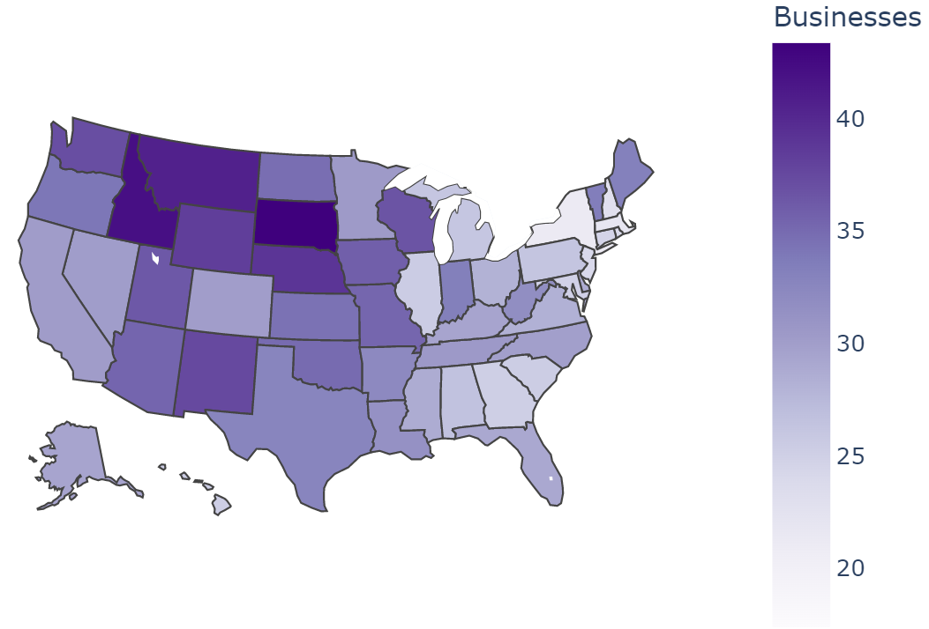
Which states have the most family-owned businesses?
Percent of
Total Businesses

Slide 18

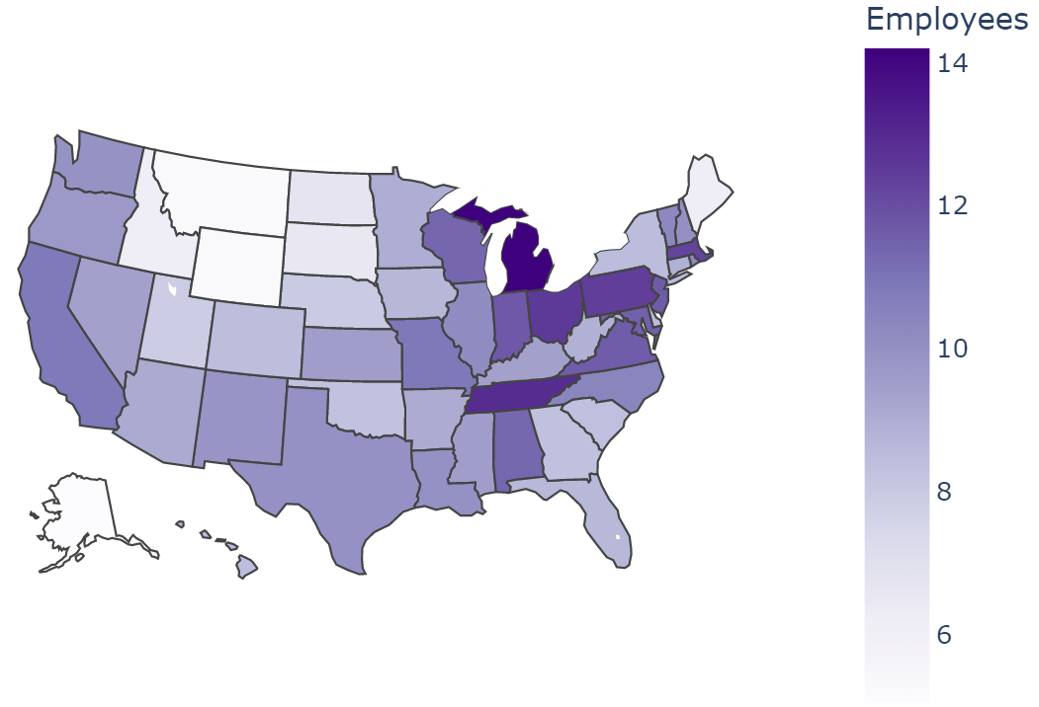
Which states have the most employees per family-owned business?

Slide 19
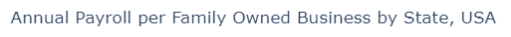
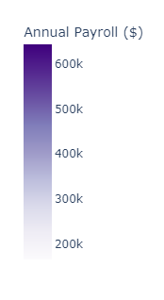
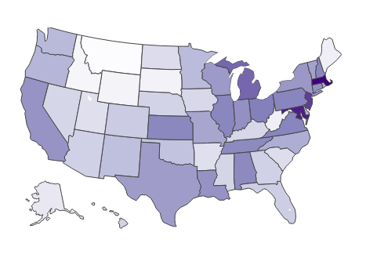
Does annual payroll differ between states for family-owned businesses

Slide 20
Summary

Slide 21

In Comparison
Family-owned businesses appear to act differently than non-family-owned businesses
More average employees
Less businesses
Less male-dominated
Less revenue

Slide 22
WHAT WE LEARNED
The states with the most total family-owned businesses are the most populated states
The states with lower populations have a larger proportion of family-owned businesses

Slide 23
Questions?

Slide 24
Sources
https://www.census.gov/data/developers/data-sets/abs.2019.html

